Slide 1
Jermyn Borough Council Meeting
06/20/2024

Slide 2
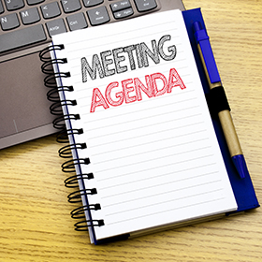
Meeting Agenda
June 20,2024
CALL TO ORDER
PLEDGE OF ALLEGIANCE
ROLL CALL
PREVIOUS MEETING MINUTES
TREASURER REPORT/BILLS PAYABLE
SECRETARY REPORT
CORRESPONDENCE
PUBLIC COMMENT
PROFESSIONAL REPORTS-POLICE, FIRE, SOLICITOR, ZONING, ENGINEER, TAX COLLECTOR, MAYOR
COMMITTEE REPORTS-SAFETY, PLANNING, FINANCE, SHADE TREE, REC, MS4, DPW
OPEN COUNCIL SEAT APPOINTMENT
BRIDGE STREET PARKING ORDINANCE # 15-2024
LSA GRANT DPW VEHICLE PURCHASING PROJECT RESOLUTION #16-2024
EXECUTIVE SESSION
NEW BUSINESS

Slide 3
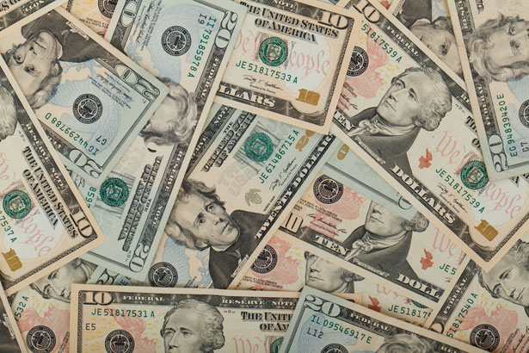
Treasurer’s report
6/20/2024
ASSETS
Checking/Savings
American Rescue Plan Fund 135,757.57
Capital Reserve - DPW 909.55
Capital Reserve - Police 5,744.82
Crime Watch Fund 222.69
General Fund - Community 248,715.19
General Fund - FNB 5,977.87
Holiday Lights Fund 1,459.09

Slide 4
Treasurer’s report
Investment - General Fund 1,087.89
Investment - Liquid Fuels 23,953.17
Investment - Paving Fund 1,099.22
Investment - Recycling 120.14
Investment - Refuse 171.32
Liquid Fuels - FNB 54,710.27
Petty Cash 196.50
Recreations Fund 24,496.09
Recycling - Community 3,468.14
Refuse Checking - FNB 284,494.91
Total Checking/Savings 792,584.43

Slide 5
Treasurer’s report
200000 · Accounts Payable 55,047.69
Long Term Debt 164,055.99

Slide 6
MS4 Minute
https://www.youtube.com/watch?v=sBhzpZD8i8s

Slide 7


